Slide 1

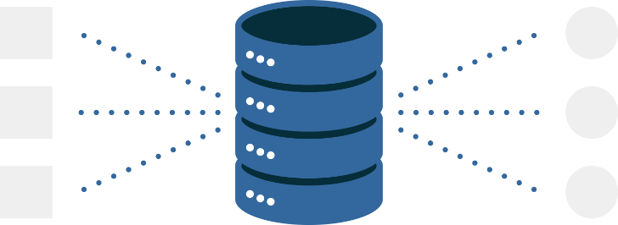
Database Management System- Overview
Lecture 1
Fahad Maqbool
Department of Computer Science

Slide 2
Agenda
DIKW Pyramid
Databases Overview
Types of Databases
Relational Databases

Slide 3
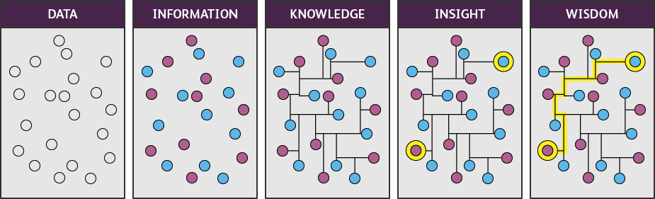
Data - Information - Knowledge - Wisdom

Slide 4
DIKW Pyramid
Wisdom
Knowledge
Information
Data
Know – Why
Know – What
Know – How
Know – Nothing

Slide 5

DIKW Pyramid
Muddling Through → Red
Efficiency → Facing a traffic light on the corner turned red.
Effectiveness → The Traffic light I am driving towards has turned red.
Explicability → I better stop the car.

Slide 6




Database vs Database Management System
Database
An organized collection of logically related structured information, or data, typically stored electronically in a computer system.
A set of data that is organized in such a way that is easy to access, manage, and update them.
Database Management System
A software system that enables users to define, create, maintain, and control access to the database

Slide 7


DBMS
SQL
Database Management System
DB 1
DB 2
DB 3

Slide 8
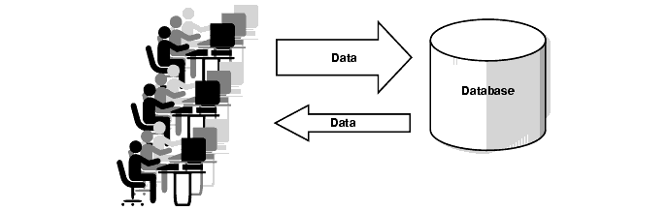
Online Transaction Processing(OLTP) System

Slide 9
Basic Concepts
Data Science
Study of data to extract meaningful insights for business
Data Analysis
Exploratory: Drill down into collected data to identify any relationships between data sets.
Descriptive: Summarizes a set of data, including measurements and patterns.
Data Engineering
Development, implementation, and maintenance of systems and processes that take in raw data and produce high-quality, consistent information that supports downstream use cases, such as analysis and machine learning.

Slide 10
Centralized
Distributed
NoSQL
Relational
Network
Object Oriented
Hierarchal

Slide 11
Centralized DBMS
Data is at a centralized place while users access data from different locations.
+ive
Simple Data management
Maintains data consistency
Less costly
-ive
Large DB sizes may increase the response time.
Server failure may result in complete data loss.

Slide 12



Distributed DBMS
Data is distributed among different database systems
Homogeneous
Heterogeneous
+ive
Modular Development
Data Reliability
-ive
Difficult to maintain.

Slide 13
RDBMS: Building Blocks
Table
Relation
Tuple
Object, …
Attribute?
Dimension, …

Slide 14
Integrities
Def: Data is correct according to their domain, business rules, and references.
Integrity Constraint: A set of rules that are used to maintain data integrity.
How does data become incorrect?
Hardware Failure, Incomplete Updates, Software Defects, Invalid data, Human errors

Slide 15

Strange !!!
How does data become invalid?
What is human error?

